Slide 1

Unit–2: Associations and Correlations
Market Basket Analysis & Frequent Itemset Mining
Presented by: Jiya Chaudhary
Registration Number: RA2311003030560
Course: B.Tech CSE (Core)

Slide 2
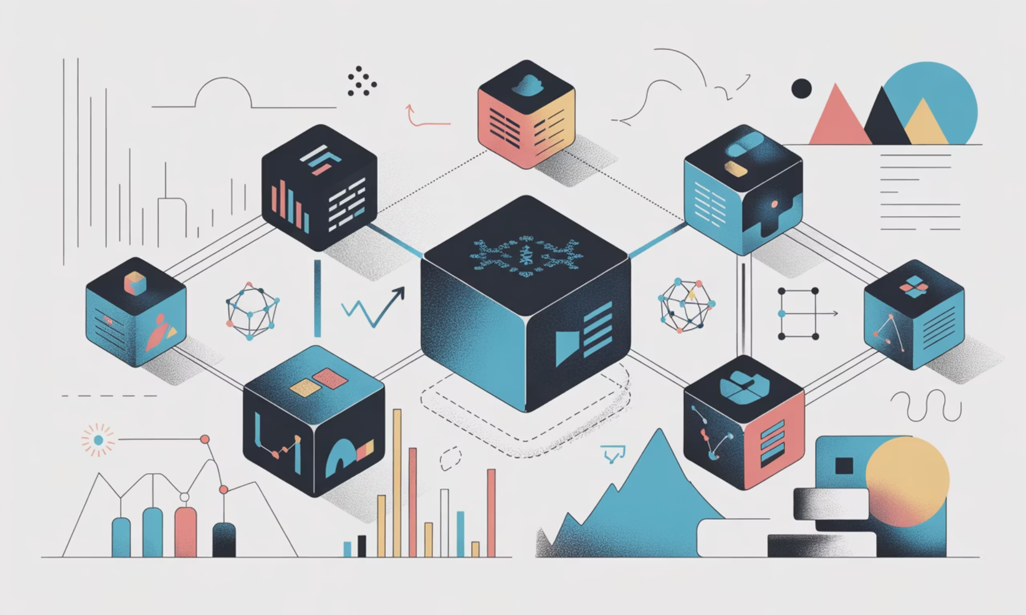
Introduction to Associations & Correlations
Association Analysis
Association analysis discovers meaningful relationships between items in large datasets by identifying which items occur together frequently. This powerful technique uncovers hidden patterns in transactional data.
Correlation
Correlation measures the strength and direction of relationships between items, helping us understand patterns and dependencies within data.
Why It Matters
These techniques improve business decision-making and power modern recommendation systems that suggest products you're likely to want.

Slide 3


Market Basket Analysis
What Is It?
Market basket analysis examines customer purchasing behaviour to identify frequently purchased item combinations. It answers the question: "What products do customers tend to buy together?"
Classic Example: Customers who purchase bread often buy butter as well – a simple but powerful insight for retailers.
Product Placement
Cross-Selling
Recommendations
Optimise supermarket shelf arrangements based on purchasing patterns
Design effective promotions and bundle offers
Power e-commerce product suggestion engines

Slide 4

The Apriori Algorithm
1
2
3
The Apriori Principle
Candidate Generation
Rule Formation
If an itemset is frequent, then all of its subsets must also be frequent. This anti-monotone property is the foundation of the algorithm.
The algorithm generates candidate itemsets level by level, pruning those that don't meet the minimum support threshold.
Frequent itemsets are used to generate association rules that meet minimum confidence requirements.
Support
Frequency of itemsets
Key Measures
Association Metrics
Support: How frequently items appear together in transactions
Confidence: The strength and reliability of the association rule
Lift: How much more likely items appear together versus independently
Lift
Confidence
Importance of association
Strength of implication
These three measures work together to evaluate the quality and significance of discovered associations.

Slide 5




Mining Without Candidate Generation
The Apriori Challenge
Traditional Apriori generates enormous numbers of candidate itemsets, leading to high computational costs in both time and memory usage, especially with large datasets.
FP-Tree Structure
Compresses database into a compact tree representation
The FP-Growth Solution
The FP-Growth (Frequent Pattern Growth) algorithm elegantly sidesteps candidate generation entirely by using a compact FP-Tree data structure.
Direct Mining
Mines patterns directly without generating candidates
Superior Performance
Significantly faster and more memory-efficient than Apriori

Slide 6
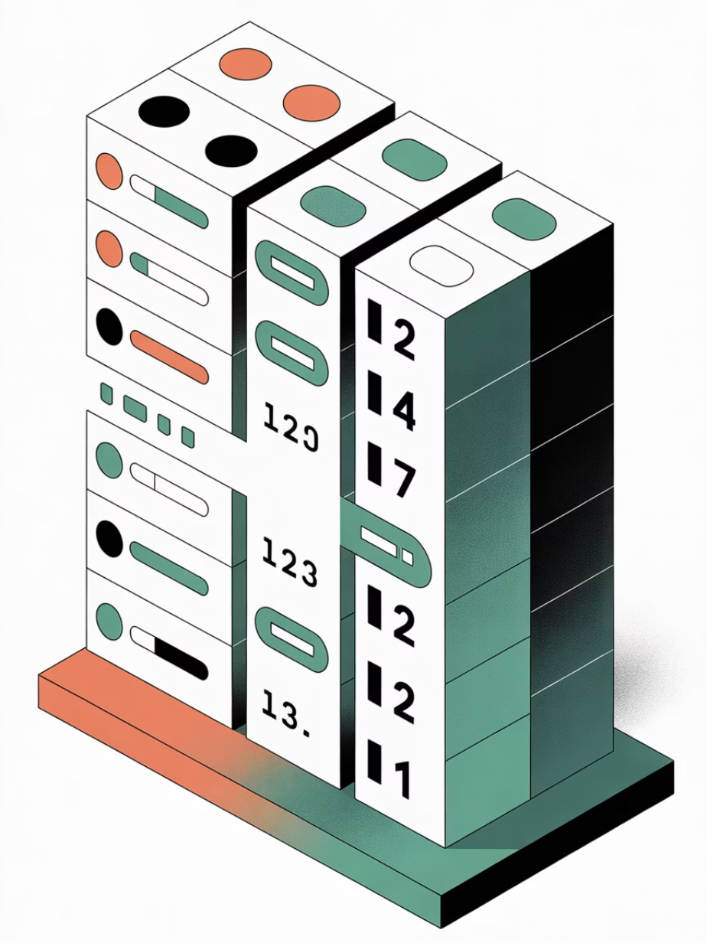



Mining Using Vertical Data Format
Vertical Data Representation
Instead of storing transactions as rows of items, vertical format stores each item mapped to its list of transaction IDs (TID sets). This simple transformation unlocks significant performance gains.
The ECLAT Algorithm
ECLAT (Equivalence Class Transformation) leverages vertical format by performing efficient set intersections on TID lists. It's particularly effective for dense datasets where items appear in many transactions.
Faster Operations
Reduced Scanning
Dense Dataset Advantage
Set intersection on TID lists is computationally efficient
Database needs to be scanned only once initially
Excels when items frequently appear together

Slide 7
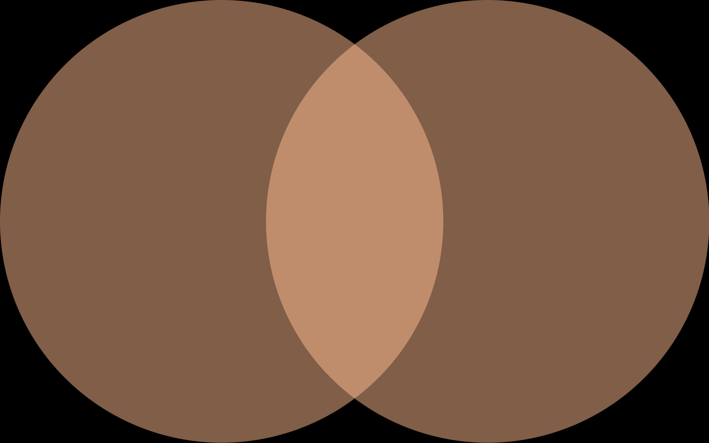
Mining Closed Frequent Itemsets
Closed & Frequent
What Are Closed Itemsets?
Frequent Itemsets
Closed Itemsets
A closed frequent itemset is one that has no immediate superset with exactly the same support count. This definition captures maximal patterns without redundancy.
Closed itemsets eliminate redundancy whilst preserving complete information about support counts.
Removes Redundancy
Reduces Size
Retains Information
Eliminates duplicate pattern information
Produces much more compact result sets
Preserves all frequency information completely

Slide 8


